Slide 1
Kerberos Overview

Slide 2
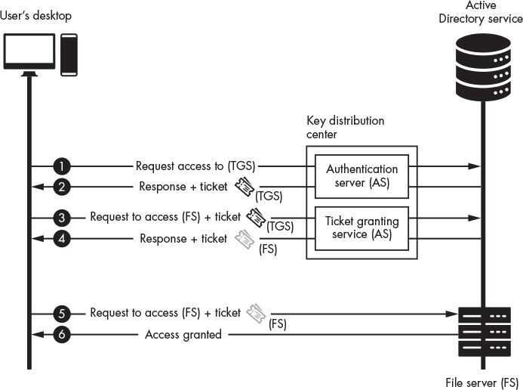

Slide 3
Cryptographic Details of Kerberos
Here we use the { } syntax to denote encryption. So, {M}_{k} means that Message M has been encrypted with key k.
We use the : syntax to denoted that a packet contains an encrypted message. While, A : {M}_{k} , means that packet A contains a message M that we have encrypted with a key k.
Finally, we use the + notation to denote additional packets; A: {M}_{k} + B: {Q}_{k} represents two packets A and B, where B contains a message Q that we’ve encrypted with the same key.

Slide 4
U
K_{u}
User’s secret symmetric key
K_{u}
Uid + Timestamp
A
Looks up username and gets Private Key
{K_{u,t}}
K_{u}
The authentication Server will generate a new symmetric key K_{u,t} and encrypts it with user secret Key K_{u}

Slide 5
U
K_{u}
User’s secret symmetric key
K_{u}
Uid
A
Looks up username and gets Private Key
{K_{u,t}}
K_{u}
+ TGT: {K_{u,t}}
K_{t}
The ticket granting service will also need a copy of symmetric key so the authentication server Generate a Ticket Granting Ticket that contain the newly generated key but encrypted with Ticket Granting Services semetric key.

Slide 6
U
K_{u}
User’s secret symmetric key
K_{u}
Uid
A
Looks up username and gets Private Key
{K_{u,t}}
K_{u}
+ TGT: {K_{u,t}}
K_{t}
{F}
+ TGT: {K_{u,t}}
T
K_{u, t}
K_{t}
Ticket Granting Service (TGS)
K_{t}

Slide 7
U
K_{u}
User’s secret symmetric key
K_{u}
Uid
A
Looks up username and gets Private Key
{K_{u,t}}
K_{u}
+ TGT: {K_{u,t}}
K_{t}
{F}
+ TGT: {K_{u,t}}
T
K_{u, t}
K_{t}
Ticket Granting Service (TGS)
K_{t}
{K_{u,f}}
+ ST: {K_{u,f}}
K_{u, t}
K_{f}

Slide 8
U
K_{u}
User’s secret symmetric key
K_{u}
{F}
+ TGT: {K_{u,t}}
T
K_{u, t}
K_{t}
Ticket Granting Service (TGS)
K_{t}
{K_{u,f}}
+ ST: {K_{u,f}}
K_{u, t}
K_{f}
{Request}
K_{u, f}
+ ST: {K_{u,f}}
F
K_{f}
File Server (FS)
K_{f}
{Approved}
K_{u, f}
K_{f} is service key in Active Directory

Slide 9
Now one more time with Attacks.

Slide 10
U
K_{u}
User’s secret symmetric key
K_{u}
Uid + Timestamp
A
Looks up username and gets Private Key
{K_{u,t}}
K_{u}
The authentication Server will generate a new symmetric key K_{u,t} and encrypts it with user secret Key K_{u}

Slide 11
U
K_{u}
User’s secret symmetric key
K_{u}
Uid
A
Looks up username and gets Private Key
{K_{u,t}}
K_{u}
+ TGT: {K_{u,t}}
K_{t}
The ticket granting service will also need a copy of symmetric key so the authentication server Generate a Ticket Granting Ticket that contain the newly generated key but encrypted with Ticket Granting Services semetric key.
If preauthenticaiton is disabled for a user. We can request TGT. And associated session key K_{u,t} is encrypted NT hash of the user’s password K_{u}
We can capture this packet and crack it by brute forcing K_{u}
Roasting: ASREProasting

Slide 12
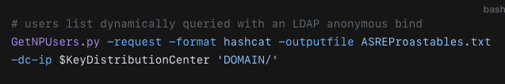
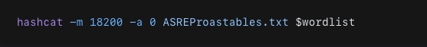

Slide 13
U
K_{u}
User’s secret symmetric key
K_{u}
Uid
A
Looks up username and gets Private Key
{K_{u,t}}
K_{u}
+ TGT: {K_{u,t}}
K_{t}
{F}
+ TGT: {K_{u,t}}
T
K_{u, t}
K_{t}
Ticket Granting Service (TGS)
K_{t}
Golden Ticket Attack:
Kt = Krbtgt (in Active Directory).
If we have Krbtgt we can generate Ticket granting Tickets at will ☺. And access anything we want ☺
Comprise the domain controller and this is yours

Slide 14
U
K_{u}
User’s secret symmetric key
K_{u}
Uid
A
Looks up username and gets Private Key
{K_{u,t}}
K_{u}
+ TGT: {K_{u,t}}
K_{t}
{F}
+ TGT: {K_{u,t}}
T
K_{u, t}
K_{t}
Ticket Granting Service (TGS)
K_{t}
{K_{u,f}}
+ ST: {K_{u,f}}
K_{u, t}
K_{f}

Slide 15
Kerberosting Explained.
U
K_{u}
User’s secret symmetric key
K_{u}
{F}
+ TGT: {K_{u,t}}
T
K_{u, t}
K_{t}
Ticket Granting Service (TGS)
K_{t}
{K_{u,f}}
+ ST: {K_{u,f}}
K_{u, t}
K_{f}
Brute for this hash (Hash Cat)
The attacker uses this account to request Kerberos service tickets (ST) for Service Principal Names (SPNs) associated with service accounts

Slide 16
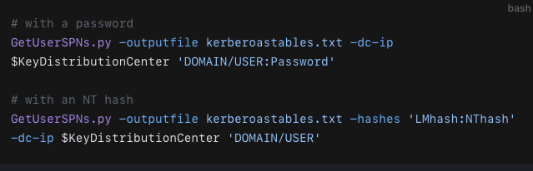
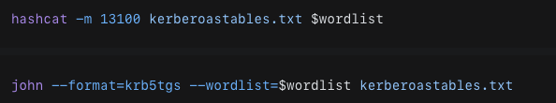

Slide 17
U
K_{u}
User’s secret symmetric key
K_{u}
{F}
+ TGT: {K_{u,t}}
T
K_{u, t}
K_{t}
Ticket Granting Service (TGS)
K_{t}
{K_{u,f}}
+ ST: {K_{u,f}}
K_{u, t}
K_{f}
{Request}
K_{u, f}
+ ST: {K_{u,f}}
F
K_{f}
File Server (FS)
K_{f}
{Approved}
K_{u, f}
K_{f} is service key in Active Directory

Slide 18
Silver Ticket Attack.
Pass the Ticket..
K_{u}
If we get access to service key K_{f}
We can for request generating K_{u, f}
Create a fake ST: by encrypting with service key K_{f.}
U
{Request}
K_{u, f}
+ ST: {K_{u,f}}
F
K_{f}
File Server (FS)
K_{f}
{Approved}
K_{u, f}
K_{f} is service key in Active Directory

Slide 19
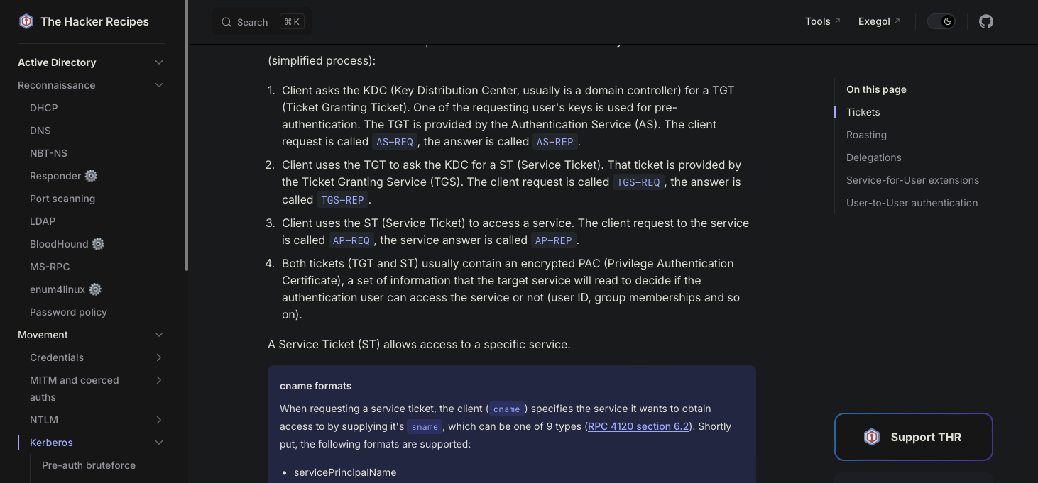
The Hacker Recipes
https://www.thehacker.recipes

Slide 20
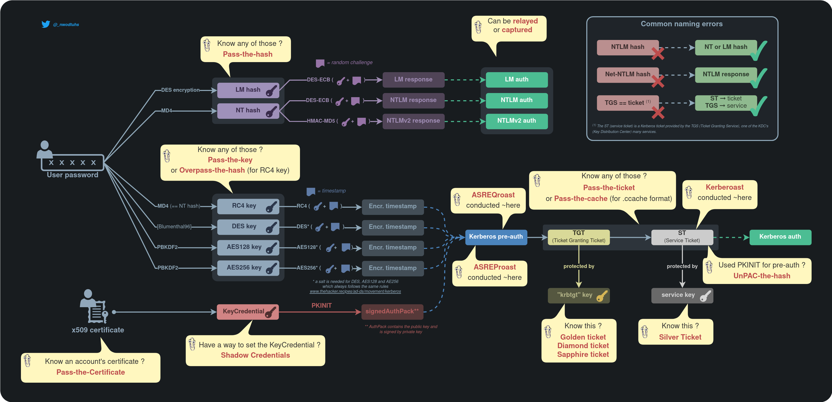
https://www.thehacker.recipes/assets/Pass%20the%20things%20(dark).DGoYJB0B.png

