Slide 1
ACTIVE DIRECTORY

Slide 2




Manager
M1
Teller 1
Customer
M2
Teller 2
Server with
Salary data
Server with Banking data
Domain Controller
Server Room

Slide 3
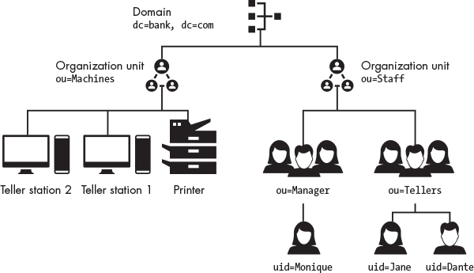
Structure of Active Directory

Slide 4
Distinguished Name (DN)
A Distinguished Name (DN) describes the full path to an object in uid=Dante, ou=Tellers, ou = Staff, dc=bank, dc=com

Slide 5
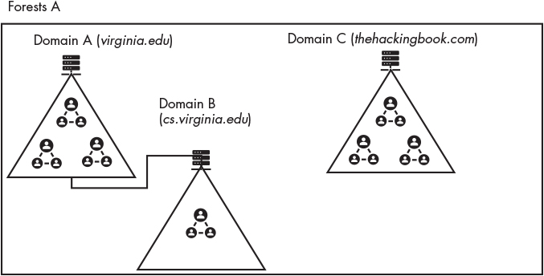
Active Directory Organization
Domain Policy: Enterprise-Wide
Group Policy Object
Manages application

Slide 6
NTLM Protocolm (NT Land Manger)
Teller Desktop
Server with Banking data
Domain Controller
Username
Password
Stores a copy of the password hash
Request access to server
nonce
Ercypt(nonce, password_hash)
Ercypt(nonce, password_hash)
User, nonce
Looks up user, get password hash, decrypts nonce and compares
Authenticated

Slide 7
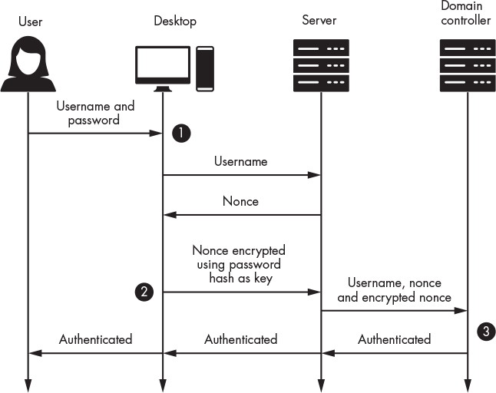

Slide 8
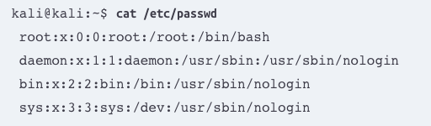
Where are these password hashes stored

Slide 9
LSASS (Local Security Authority Subsystem Service)
LSASS is a process in Microsoft Windows operating systems responsible for enforcing security policies on the system. It handles user authentication, password management, and security token creation. When you log into your computer, LSASS verifies your credentials with the system’s security database (like the SAM - Security Accounts Manager)

Slide 10
NTDS.DIT
This the Database (C:\Windows\NTDS\NTDS.DIT ) that stores all the AD Data including:
  User and Group objects
  Group membership
  Password Hashes for all users on the domain ← Important for Pentesters
  If active directory is misconfigured the database can also store plain text version of the password.

Slide 11
History of LMs
LM hash introduced in 1987 (Windows Vista/Sever 2008)
Password(14)
Uppercase(password)
First 7
First 7
Key
Padded with null
KGS!@#$%
KGS!@#$%
DES
DES
Concatenated
Really bad, easy to brute force.
299bd128c1101fd6

Slide 12
Version of NTML
Hash/Protocol | Cryptographic technique | Mutual Authentication | Message Type | Trusted Third Party
NTLM | Symmetric key cryptography | No | Random number | Domain Controller
NTLMv1 | Symmetric key cryptography | No | MD4 hash, random number | Domain Controller
NTLMv2 | Symmetric key cryptography | No | MD4 hash, random number | Domain Controller
Kerberos | Symmetric key cryptography & asymmetric cryptography | Yes | Encrypted ticket using DES, MD5 | Domain Controller/Key Distribution Center (KDC)

Slide 13
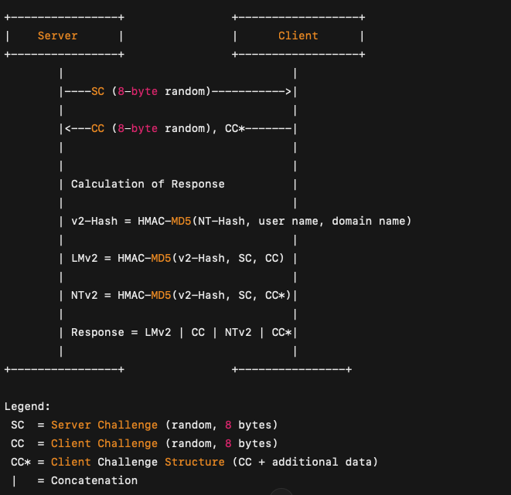
NLMV2 Hash Calculations

Slide 14
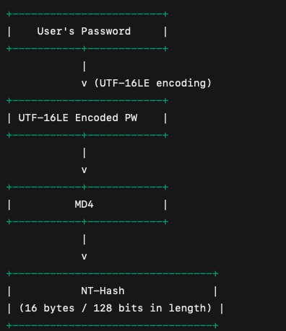
NT-HASH
Let’s compute the NT Hash for the password "Password123":
Password: "Password123"
Unicode UTF-16LE Encoding:
  P → 0x0050 → 50 00
  a → 0x0061 → 61 00
  s → 0x0073 → 73 00
  s → 0x0073 → 73 00
  w → 0x0077 → 77 00
  o → 0x006f → 6f 00
  r → 0x0072 → 72 00
  d → 0x0064 → 64 00
  1 → 0x0031 → 31 00
  2 → 0x0032 → 32 00
  3 → 0x0033 → 33 00
  Byte sequence: 50 00 61 00 73 00 73 00 77 00 6f 00 72 00 64 00 31 00 32 00 33 00
MD4 Hash:
  Input the byte sequence into MD4.
  Output: 0x209c6174da490ca2e13f24ac6d4dee23
NT Hash:
  Hex result: 209c6174da490ca2e13f24ac6d4dee23
Calculate the MD4 hash of this encoded password:
NT-Hash = MD4(UTF-16LE(password))

Slide 15
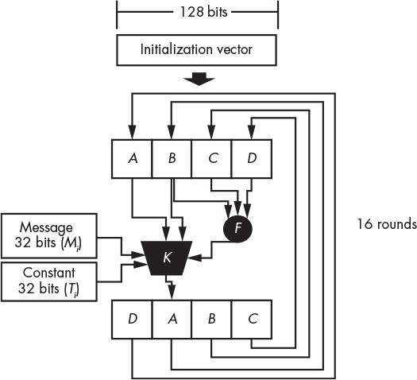
F(B, C, D) = (B and C) or (( not B) and D)
K(B, M, T, A, F) = B ⊞ ((A ⊞ F ⊞ M_{i} ⊞ T_{i}) <<< s_{i})
The ⊞ symbols represent modulo addition,
The <<< symbol represents a circular left shift
for i from 0 to 63 do
T[i] := floor(2³² × abs(sin(i + 1)))
The output of function K is used to override the value of the A block, and the blocks are rearranged by performing a circular right shift,

Slide 16
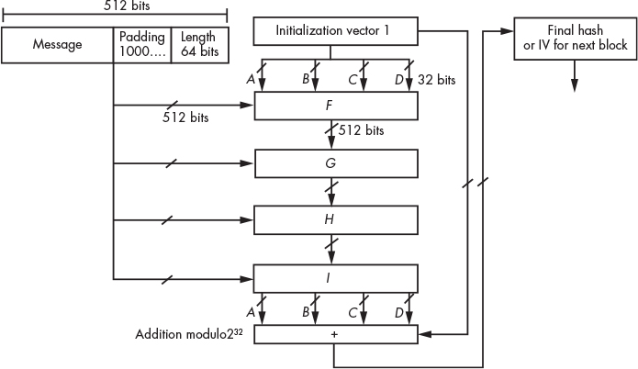
H(B, C, D) = B xor C xor D
G(B, C, D) = (B and D) or (C and ( not D))
I(B, C, D) = C xor (B or ( not D))

Slide 17
HMAC
HMAC(key, message) = Hash((key' XOR opad)
|| Hash((key' XOR ipad)
|| message))
Where:
|| represents concatenation.
XOR is the bitwise exclusive OR operation.
ipad (inner padding): 0x36 repeated to the block size of the hash (64 bytes for MD5).
opad (outer padding): 0x5c repeated to the block size of the hash (64 bytes for MD5).
key' is the original key padded or truncated to match the block size (64 bytes for MD5).

