Slide 1
ACL (Access Control List)
& BLOOD HOUND
Finding Paths to execution.

Slide 2
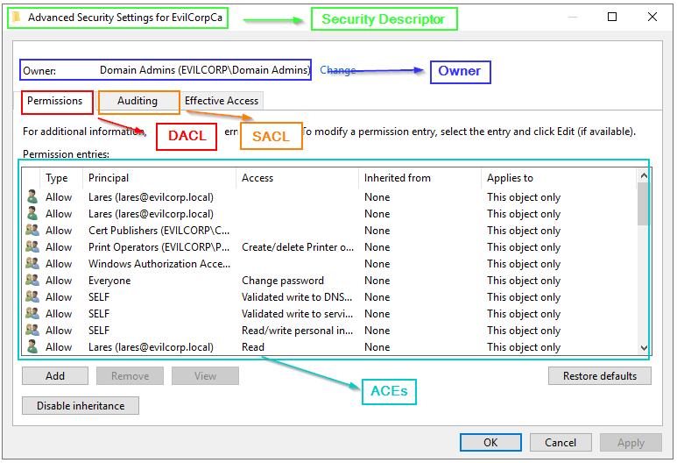

Slide 3
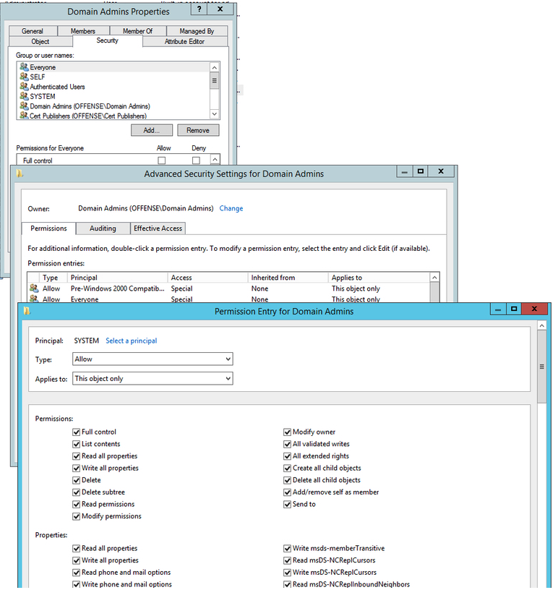

Slide 4
GenericAll - full rights to the object (add users to a group or reset user's password)
GenericWrite - update object's attributes (i.e logon script)
WriteOwner - change object owner to attacker controlled user take over the object
WriteDACL - modify object's ACEs and give attacker full control right over the object
AllExtendedRights - ability to add user to a group or reset password
ForceChangePassword - ability to change user's password
Self (Self-Membership) - ability to add yourself to a group

Slide 5
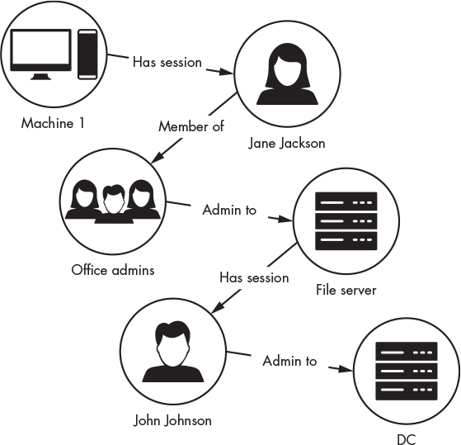
Goal is to find a path.

Slide 6
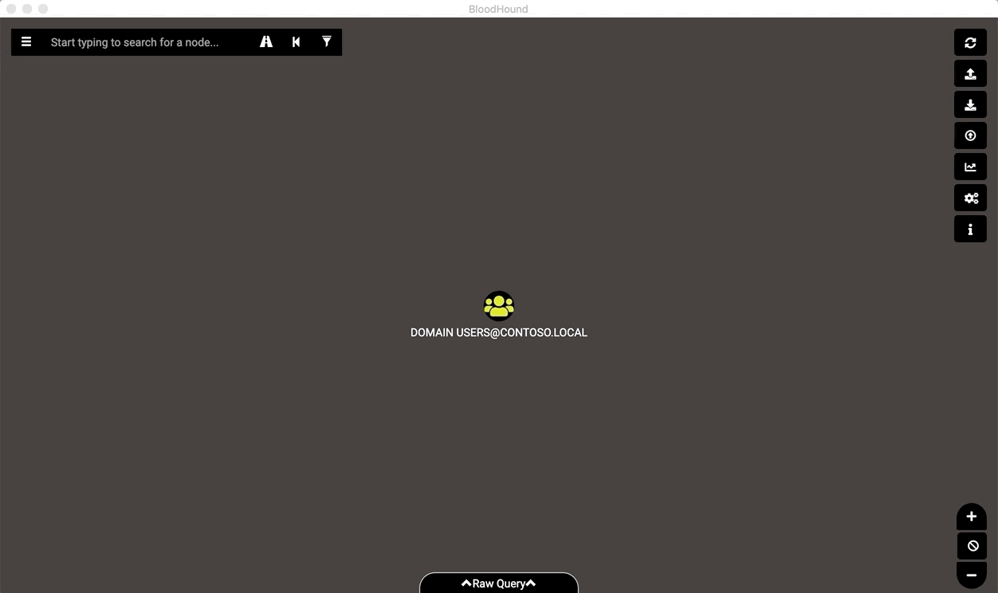
Blood Hound

Slide 7
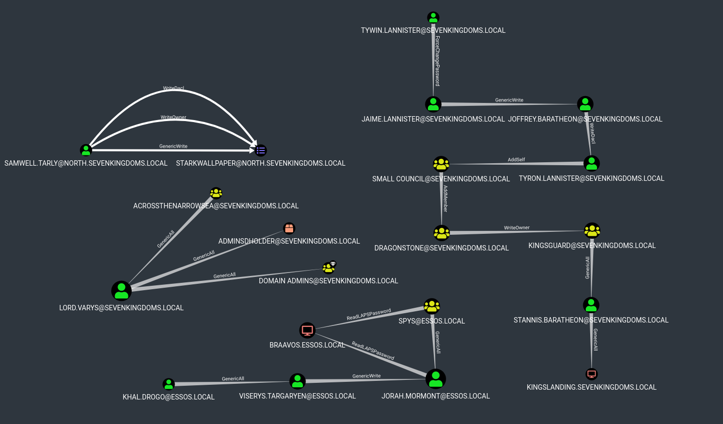

Slide 8
Sharp Hound
SharpHound issues a series of LDAP queries against the domain controller to enumerate AD objects such as computer names, groups, and user accounts
Running Sharp hound on domain joined machine
C:\> SharpHound.exe --CollectionMethods Session --Loop

Slide 9
Running Sharp Hound from a Non Domain-Joined System
1. Configure your system DNS server to be the IP address of a domain controller in the target domain.
2. Spawn a CMD shell as a user in that domain using runas and its /netonly flag, like so:
C:\> runas /netonly /user:CONTOSO\Jeff.Dimmock cmd.exe
You will be prompted to enter a password. Enter the password and hit enter.

Slide 10
Verify you’ve got valid domain authentiation by using the net binary:
C:\> net view \\contoso\
If you can see the SYSVOL and NETLOGON folders, you’re good.
5. Run SharpHound, using the -d flag to specify the AD domain you want to collect information from. You can also use any other flags you wish.
C:\> SharpHound.exe -d contoso.local

Slide 11
SharpHound vs. Antivirus
While BloodHound has plenty of defensive value, antivirus and browser vendors continue to flag SharpHound as malicious.
If you are on the red team side, you can employ some av-bypass strategies to avoid getting caught by AV. One of the best things you can do is stay completely off-disk when running SharpHound.
Many command-and-control tools have in-memory .net assembly execution capabilities, such as Cobalt Strike’s execute-assembly and Covenant’s assembly commands. Using these commands will keep SharpHound totally off-disk when run on your target, which will go a very long way toward evading basic AV signatures.

Slide 12
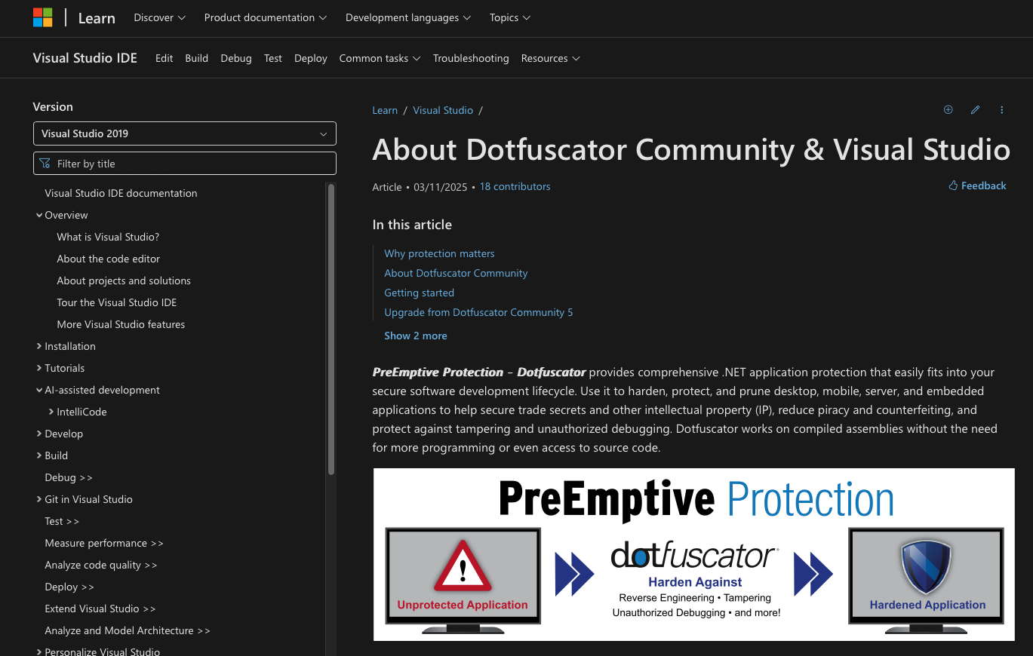
Microsoft Dotfuscatort
Developed by Microsoft for protecting IP-turns out to good at building malware so that it evades detection.
https://learn.microsoft.com/en-us/visualstudio/ide/dotfuscator/?view=vs-2019

Slide 13

Writing Obfuscation with Donut
https://github.com/TheWover/donut?tab=readme-ov-file#how

Slide 14
References
https://www.ired.team/offensive-security-experiments/active-directory-kerberos-abuse/abusing-active-directory-acls-aces
https://bloodhound.readthedocs.io/en/latest/data-collection/sharphound.html

