Slide 1
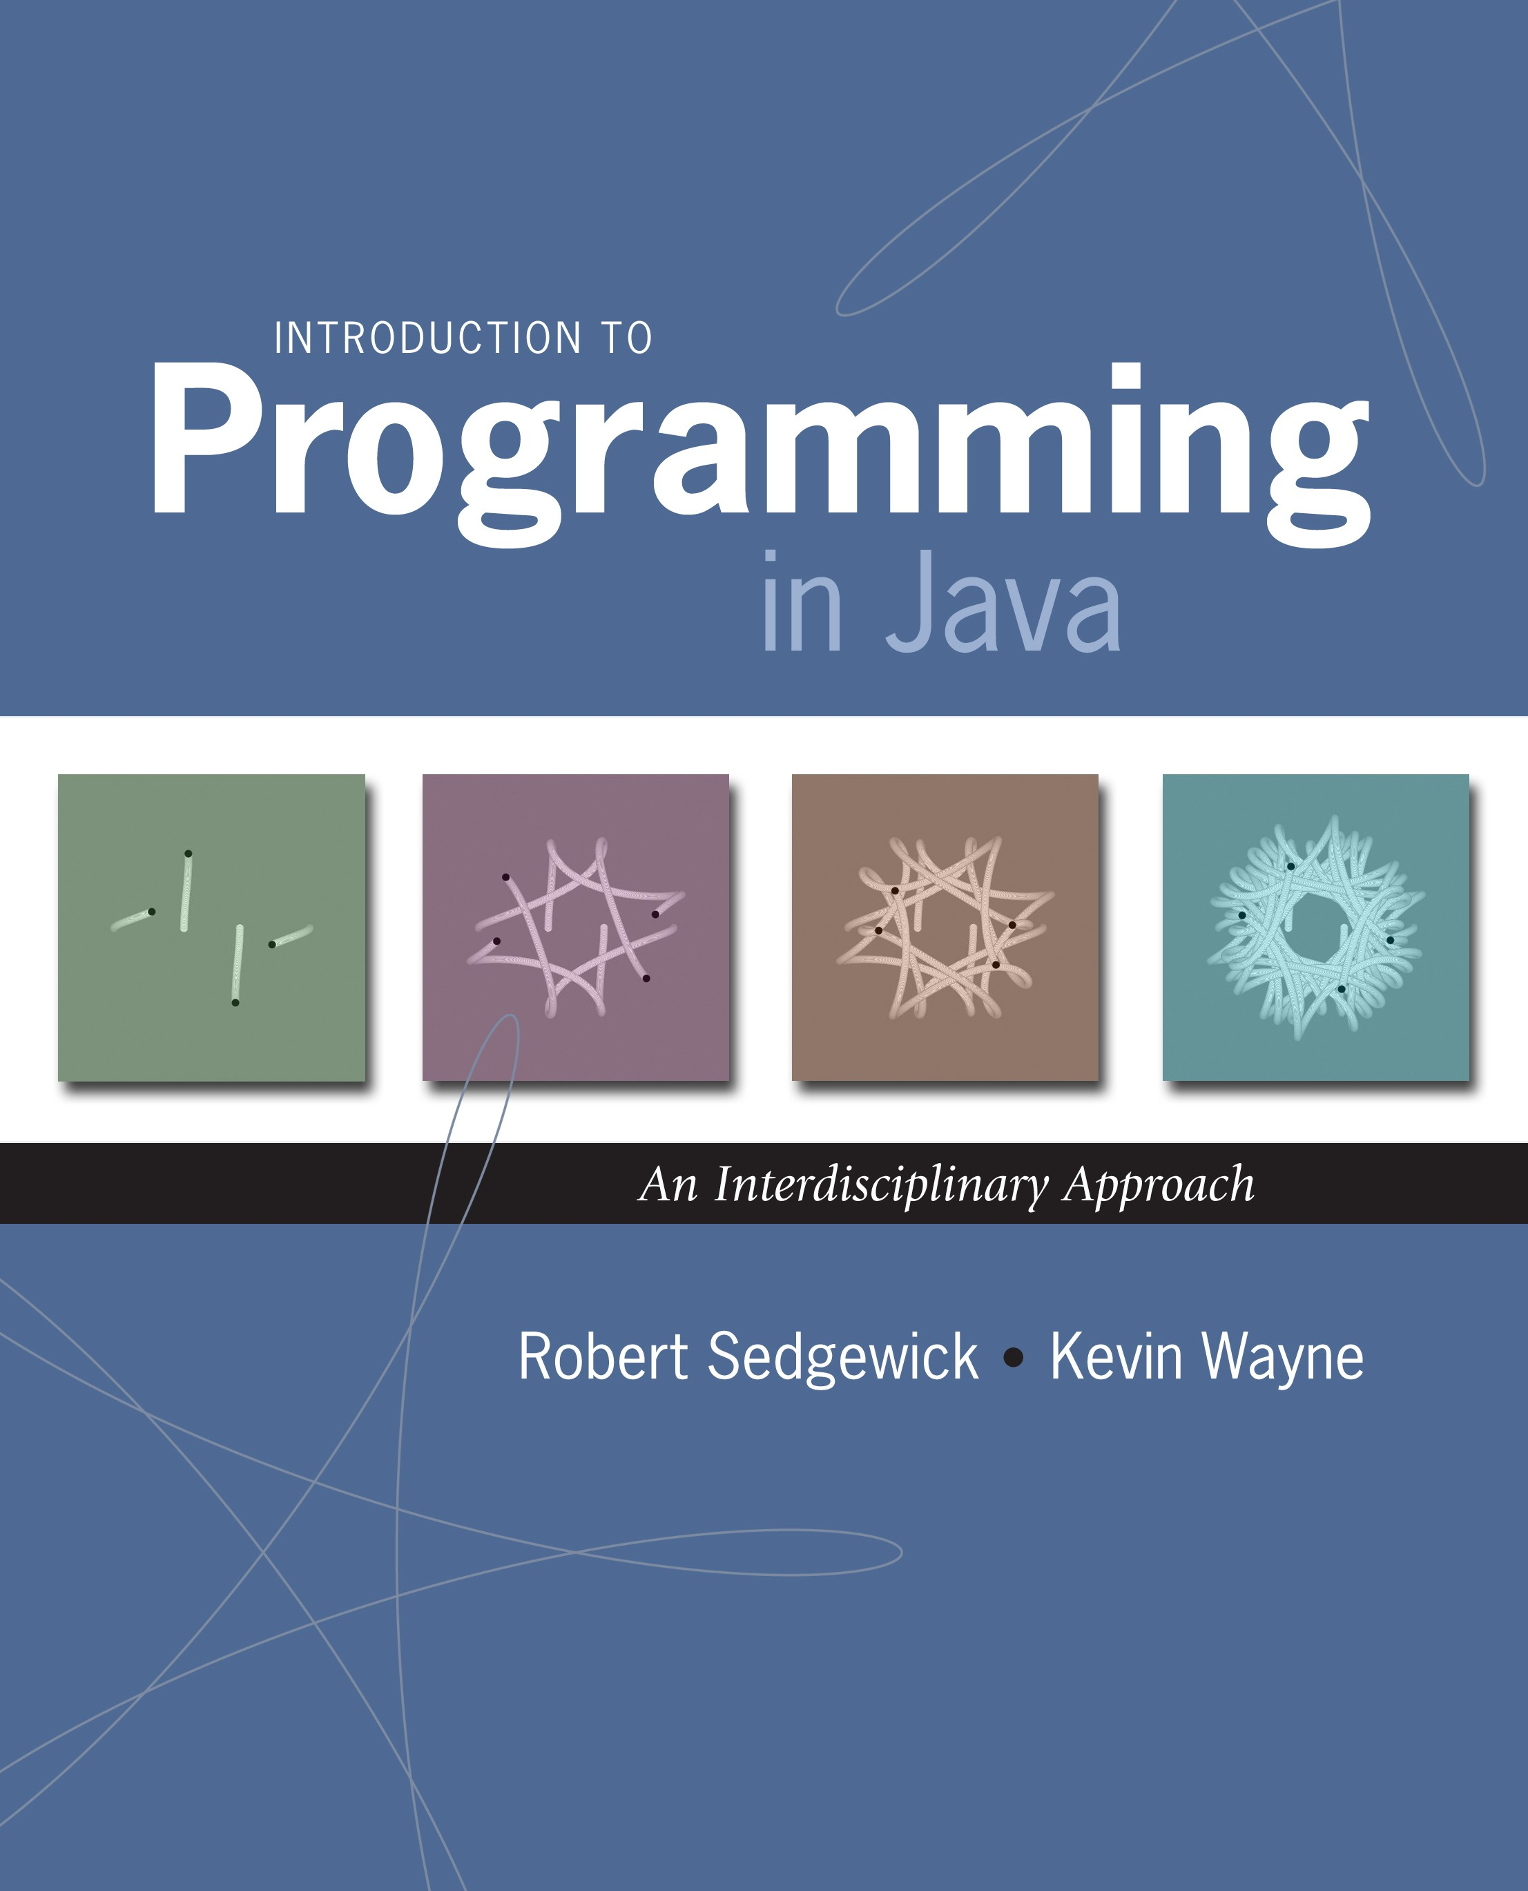
1.5 Input and Output
Introduction to Programming in Java: An Interdisciplinary Approach · Robert Sedgewick and Kevin Wayne · Copyright © 2002–2010
2/14/11 7:49 AM

Slide 2

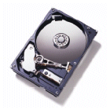

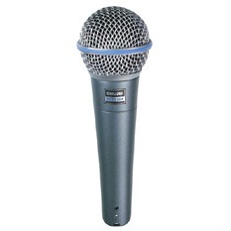
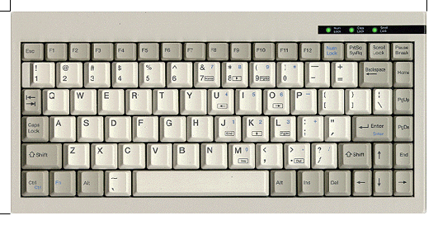
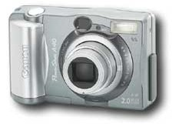
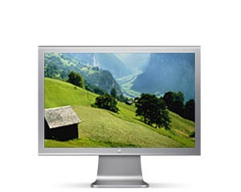
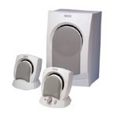
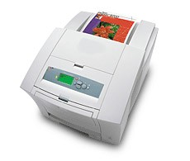

Input and Output
Input devices.
Keyboard
Mouse
Hard drive
Network
Digital camera
Microphone
Output devices.
Display
Speakers
Hard drive
Network
Printer
MP3 Player
Goal. Java programs that interact with the outside world.
2

Slide 3
Input and Output
Input devices.
Keyboard
Mouse
Hard drive
Network
Digital camera
Microphone
Output devices.
Display Speakers Hard drive Network Printer
Our approach.
Define Java libraries of functions for input and output.
Use operating system (OS) to connect Java programs to: file system, each other, keyboard, mouse, display, speakers.
MP3 Player
3

Slide 4
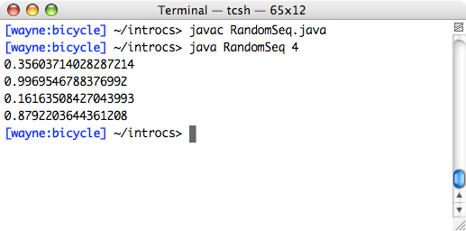
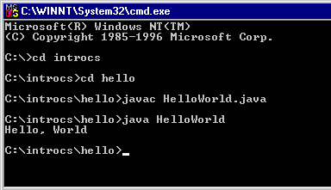
Terminal
Terminal. Application where you can type commands to control the operating system.
Mac OS X
Microsoft Windows
4

Slide 5
Command-Line Input and Standard Output
Command-line input. Read an integer N as command-line argument.
Standard output.
Flexible OS abstraction for output.
In Java, output from System.out.println() goes to standard output.
By default, standard output is sent to Terminal.
public class RandomSeq {
public static void main(String[] args) { int N = Integer.parseInt(args[0]);
for (int i = 0; i < N; i++) { System.out.println(Math.random());
}
}
}
% java RandomSeq 4
0.9320744627218469
0.4279508713950715
0.08994615071160994
0.6579792663546435
5

Slide 6
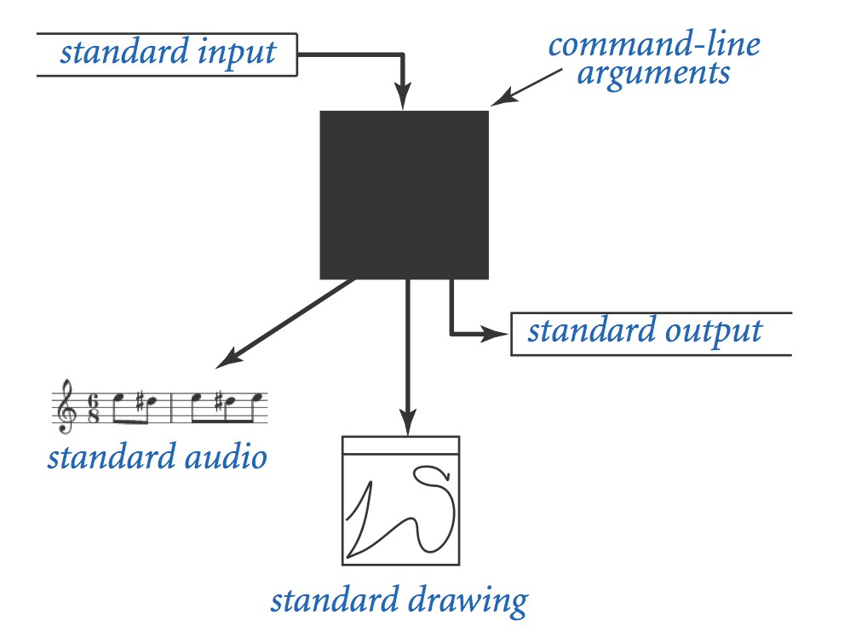
Old Bird's Eye View
6

Slide 7
New Bird's Eye View
7

Slide 8
Library
$ java transform Daniel
$ Hello DANIEL
public class Process{
public static capitalize(String input){
input = input.toUpperCase();
return input
}
}
}
public class Transform{
public static void main(String[] args){
String input = args[0];
input = Proccess.capitalize(input);
System.out.println(“Hello ”+input);
}
}
public class String{
……
public static toUpperCase(String input){
………….
………
}
}
………
}

Slide 9
Standard Input and Output

Slide 10
Command-Line Input vs. Standard Input
Command-line inputs.
Use command-line inputs to read in a few user values.
Not practical for many user inputs.
Input entered before program begins execution.
Standard input.
Flexible OS abstraction for input.
By default, standard input is received from Terminal window.
Input entered while program is executing.
9

Slide 11
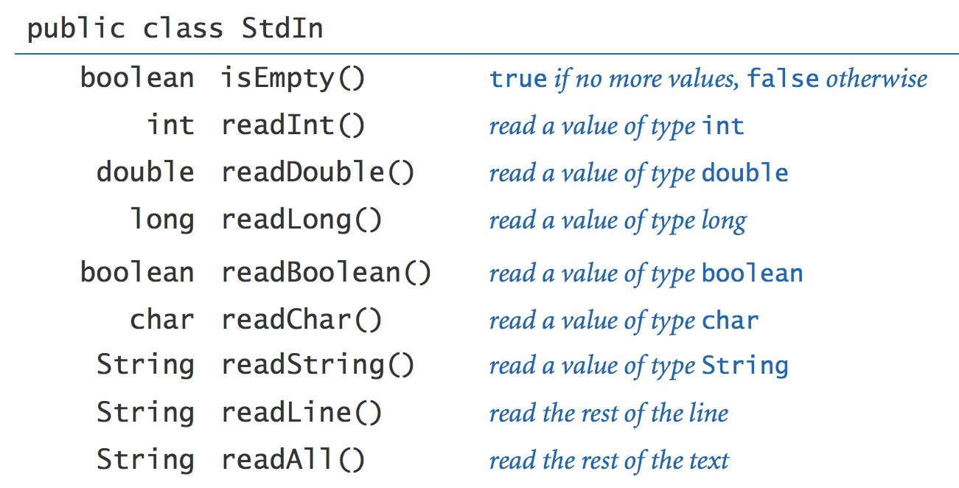
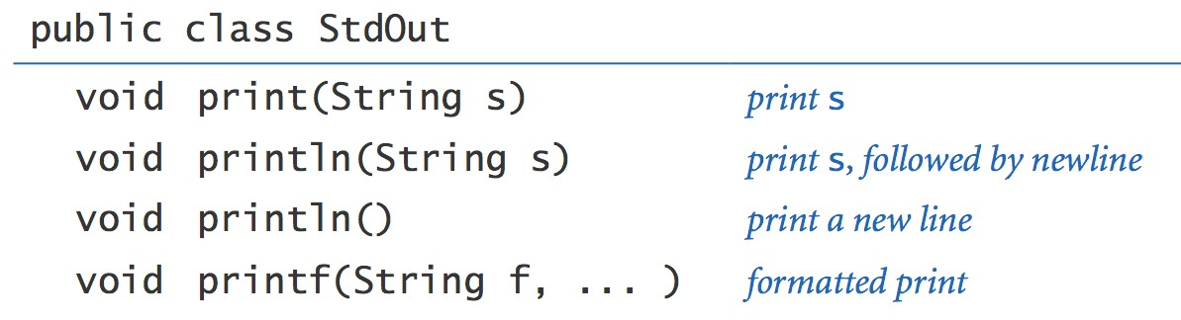
Standard Input and Output
Standard input. StdIn is library for reading text input. Standard output. StdOut is library for writing text output.
libraries developed for this course
(also broadly useful)
10

Slide 12
Standard Input and Output
To use. Download StdIn.java and StdOut.java from booksite, and put in working directory (or use classpath).
see booksite
public class Add {
public static void main(String[] args) { StdOut.print("Type the first integer: ");
int x = StdIn.readInt(); StdOut.print("Type the second integer: "); int y = StdIn.readInt();
int sum = x + y;
StdOut.println("Their sum is " + sum);
}
}
% java Add
Type the first integer: 1
Type the second integer: 2
Their sum is 3
12

Slide 13
Averaging A Stream of Numbers
Average. Read in a stream of numbers, and print their average.
public class Average {
public static void main(String[] args) {
double sum = 0.0; int n = 0;
// cumulative total
// number of values
while (!StdIn.isEmpty()) { double x = StdIn.readDouble(); sum = sum + x;
n++;
}
% java Average 10.0 5.0 6.0
3.0 7.0 32.0
<Ctrl-d>
10.5
StdOut.println(sum / n);
}
}
<Ctrl-d> for OS X/Linux/Unix/DrJava
<Ctrl-z> for Windows
Key point. Program does not limit the amount of data.
13

Slide 14
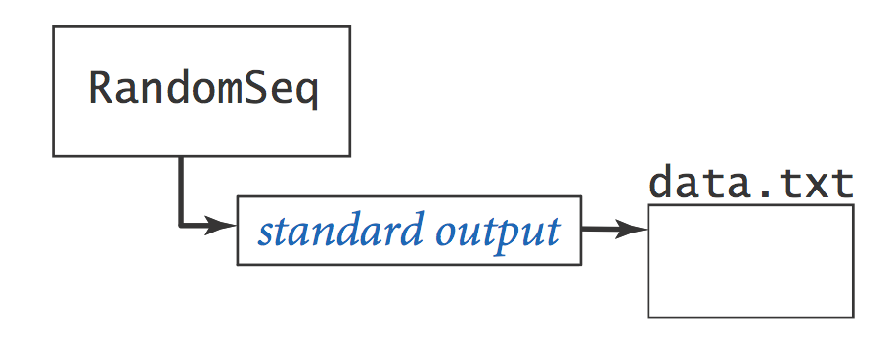
Redirecting Standard Output
Redirecting standard output. Use OS directive to send standard output to a file for permanent storage (instead of terminal window).
% java RandomSeq 1000 > data.txt
redirect stdout
14

Slide 15
Redirection and Piping

Slide 16
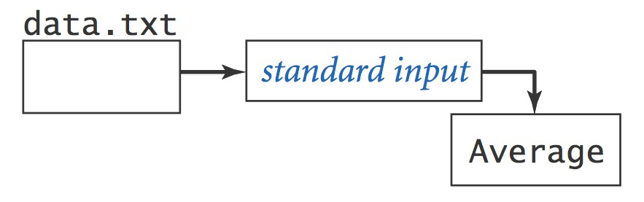
Redirecting Standard Input
Redirecting standard input. Use OS directive to read standard input from a file (instead of terminal window).
% more < data.txt
0.5475375782884312
0.4971087292684019
0.23123808041753813
…
redirect stdin
% java Average < data.txt
0.4947655567740991
16

Slide 17
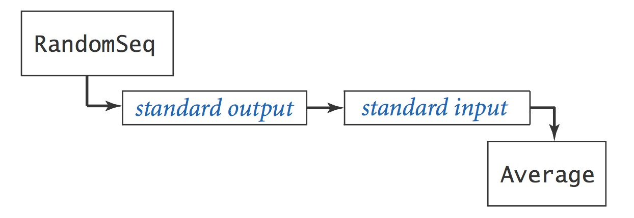
Connecting Programs
Piping.
Use OS directive to make the standard output of one program
become the standard input of another.
pipe stdout of RandomSeq
to stdin of Average
% java RandomSeq 1000000 | java Average
0.4997970473016028
% java RandomSeq 1000000 | java Average
0.5002071875644842
17

Slide 18
Standard Drawing

Slide 19
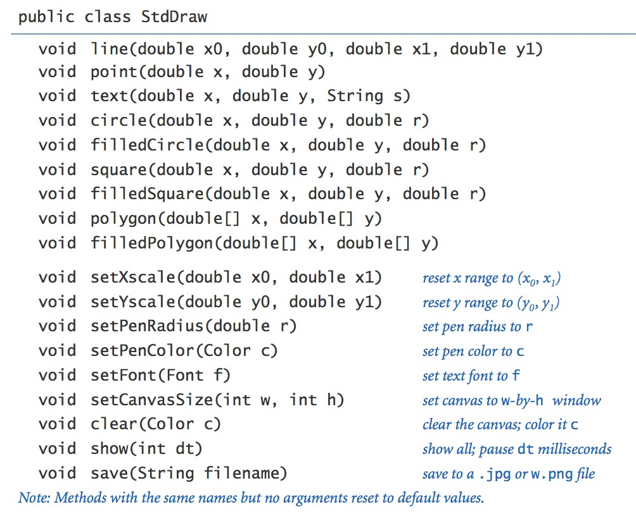
Standard Drawing
Standard drawing.
StdDraw is library for producing graphical output.
library developed for this course
(also broadly useful)
19

Slide 20
Standard Draw
Standard drawing. We provide library StdDraw to plot graphics. To use. Download StdDraw.java and put in working directory.
public class Triangle {
public static void main(String[] args) { double t = Math.sqrt(3.0) / 2.0;
StdDraw.line(0.0, 0.0, 1.0, 0.0);
StdDraw.line(1.0, 0.0, 0.5, t);
StdDraw.line(0.5, t, 0.0, 0.0); StdDraw.point(0.5, t/3.0);
}
}
(½, ½ 3^(½))
% java Triangle
(0, 0)
(1, 0)
20

Slide 21
Chaos Game
Chaos game. Play on equilateral triangle, with vertices R, G, B.
Start at R.
Repeat the following N times:
  pick a random vertex
  move halfway between current point and vertex
– draw a point in color of vertex
B: (1/2, 1/2 √ 3)
Q. What picture emerges?
B B G R B G …
2
5
1
3
6
4
0
R: (0, 0)
G: (1, 0)

Slide 22
Chaos Game
public class Chaos {
public static void main(String[] args) { int T = Integer.parseInt(args[0]);
double[] cx = { 0.000, 1.000, 0.500 };
double[] cy = { 0.000, 0.000, 0.866 };
√ 3
(avoid hardwired
constants like this)
double x = 0.0, y = 0.0;
for (int t = 0; t < T; t++) {
int r = (int) (Math.random() * 3); x = (x + cx[r]) / 2.0;
y = (y + cy[r]) / 2.0; StdDraw.point(x, y);
between 0 and 2
}
}
}

Slide 23
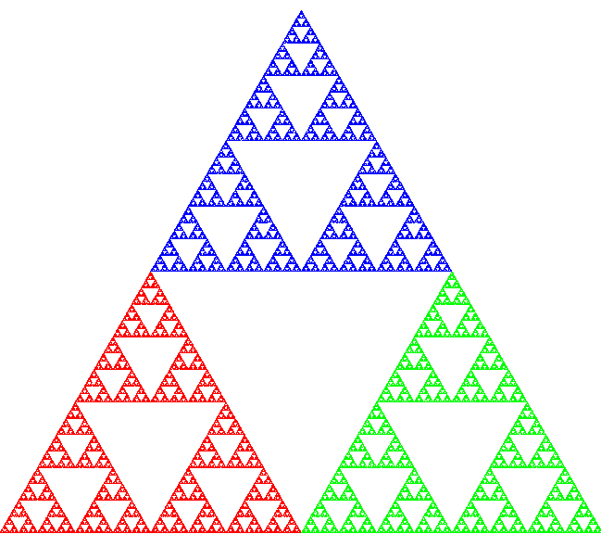
Chaos Game
Easy modification. Color point according to random vertex chosen using
StdDraw.setPenColor(StdDraw.RED) to change the pen color.
B
% java Chaos 10000
R
G
Sierpinski triangle

Slide 24

Barnsley Fern
Barnsley fern. Play chaos game with different rules.
probability |  |  | new x |  |  |  |  | new y
2% |  |  |  |  | .50 |  |  | .27y
15% | -.14x | + | .26y | + | .57 | .25x | + | .22y | - | .04
13% | .17x | - | .21y | + | .41 | .22x | + | .18y | + | .09
70% | .78x | + | .03y | + | .11 | -.03x | + | .74y | + | .27
Q. What does computation tell us about nature?
Q. What does nature tell us about computation?
20th century sciences. Formulas. 21st century sciences. Algorithms?
0 ---2 ---- 17 ----30------100
29

Slide 25
Animation
Animation loop. Repeat the following:
Clear the screen.
Move the object.
Draw the object.
Display and pause for a short while.
Ex. Bouncing ball.
Ball has position (rx, ry) and constant velocity (vx, vy).
Detect collision with wall and reverse velocity.
(+1, +1)
(vx, vy)
(rx, ry)
(-1, -1)
30

Slide 26
Bouncing Ball
public class BouncingBall {
public static void main(String[] args) { double rx = .480, ry = .860;
double vx = .015, vy = .023; double radius = .05;
StdDraw.setXscale(-1.0, +1.0);
StdDraw.setYscale(-1.0, +1.0);
position
constant velocity radius
rescale coordinates
while(true) {
if (Math.abs(rx + vx) + radius > 1.0) vx = -vx;
bounce
if (Math.abs(ry + vy) + radius > 1.0) vy = -vy;
rx = rx + vx;
ry = ry + vy;
update position
StdDraw.setPenColor(StdDraw.GRAY); StdDraw.filledSquare(0.0, 0.0. 1.0); StdDraw.setPenColor(StdDraw.BLACK); StdDraw.filledCircle(rx, ry, radius); StdDraw.show(20);
clear background
draw the ball
}
}
}
turn on animation mode: display and pause for 50ms

Slide 27

Bouncing Ball Demo
% java BouncingBall

Slide 28
Special Effects
Images. Put .gif, .png, or .jpg file in the working directory and use StdDraw.picture() to draw it.
Sound effects. Put .wav, .mid, or .au file in the working directory and use StdAudio.play() to play it.
Ex. Modify BouncingBall to display image and play sound upon collision.
Replace StdDraw.filledCircle() with:
StdDraw.picture(rx, ry, "earth.gif");
Add following code upon collision with wall:
StdAudio.play("boing.wav");

