Slide 1

Introduction to
Computer Science I

Slide 2
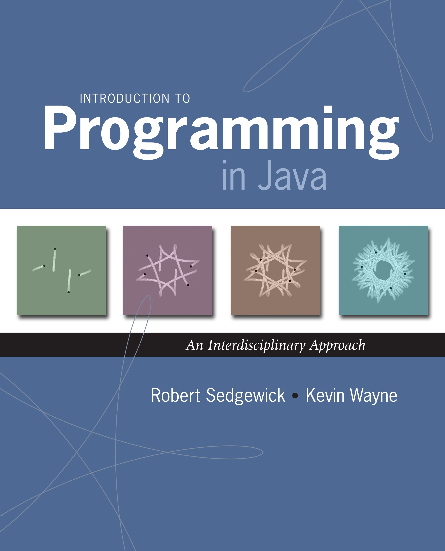
1.3 Conditionals and Loops
Introduction to Programming in Java: An Interdisciplinary Approach · Robert Sedgewick and Kevin Wayne · Copyright © 2002–2010
2/6/11 12:44 PM

Slide 3
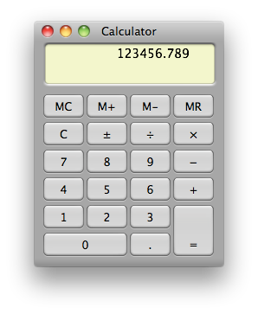
primitive data types & assignment statements
Math & text I/O
conditionals and loops
objects functions and modules
Arrays
graphics, sound, and image I/O
Construct cool programs
Recursion
last lecture: equivalent
to a calculator

Slide 4
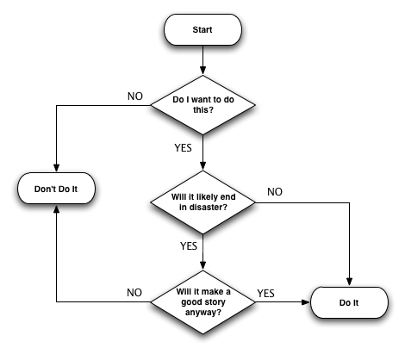
Control Flow
Control flow.
Sequence of statements that are actually executed in a program.
Conditionals and loops: enable us to create control flow.
4

Slide 5
Control Flow
Control flow.
Sequence of statements that are actually executed in a program.
Conditionals and loops: enable us to create control flow.
statement 1
statement 2
statement 3
statement 4
boolean 1
true
false
statement 1
boolean 2
true
statement 2
false
statement 3
straight-line control flow
control flow with conditionals and loops
5

Slide 6

Conditionals

Slide 7
If Statement
The if statement. A common branching structure.
Evaluate a boolean expression.
If true, execute some statements.
If false, execute other statements.
if (boolean expression) {
statement T;
can be any sequence
boolean expression
}
else {
statement F;
}
of statements
true
false
statement T
statement F
7

Slide 8
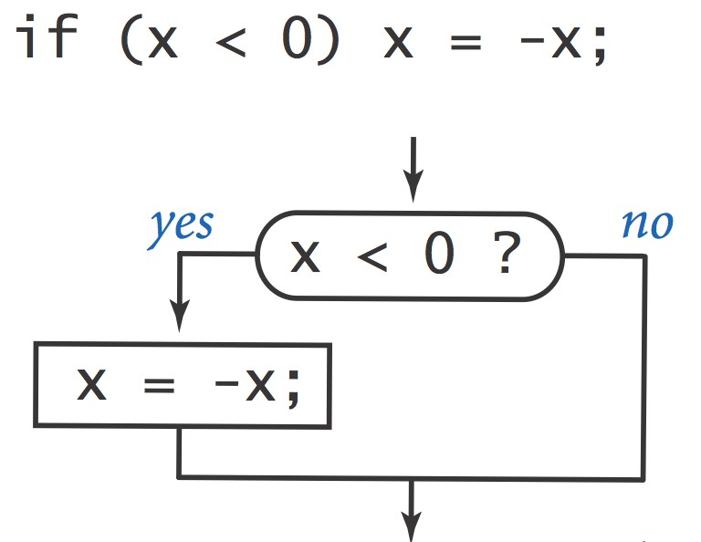
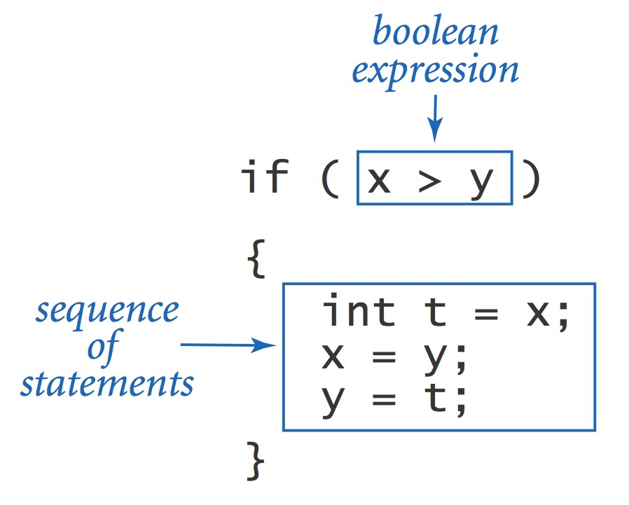
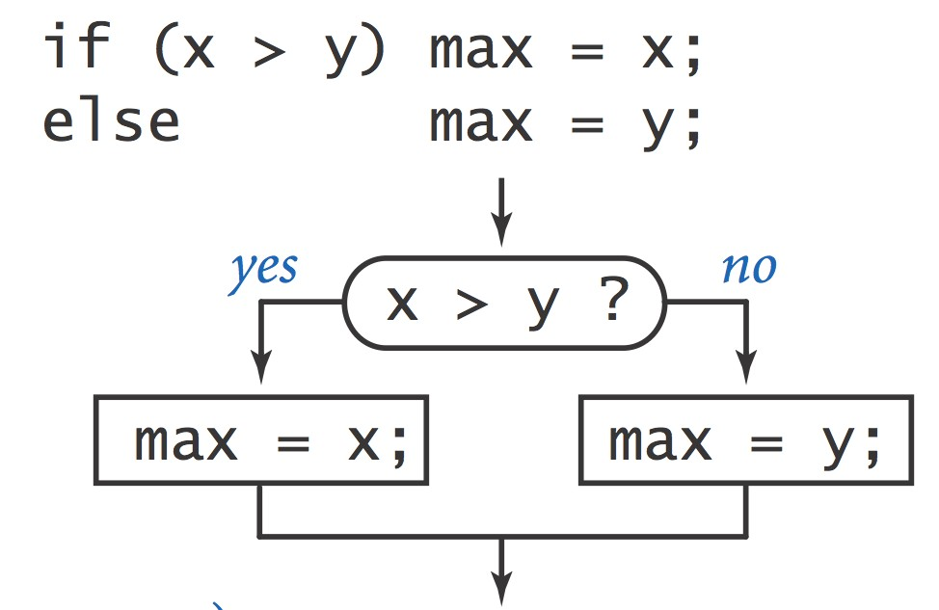
If Statement
The if statement. A common branching structure.
Evaluate a boolean expression.
If true, execute some statements.
If false, execute other statements.
8

Slide 9

If Statement
Ex. Take different action depending on value of variable.
public class Flip {
public static void main(String[] args) {
if (Math.random() < 0.5){
System.out.println("Heads");
}
Else {
System.out.println("Tails");
}
}
}
% java Flip
Heads
% java Flip
Heads
% java Flip
Tails
% java Flip
Heads
9

Slide 10

Nesting

Slide 11
Nested If Statements
Ex. Pay a certain tax rate depending on income level.
Income
Rate
0 - 47,450 22%
47,450 – 114,650 25%
114,650 – 174,700 28%
174,700 – 311,950 33%
311,950 - 35%
5 mutually exclusive alternatives
double rate;
if |  | (income | < | 47450) | rate | = | 0.22;
else | if | (income | < | 114650) | rate | = | 0.25;
else | if | (income | < | 174700) | rate | = | 0.28;
else | if | (income | < | 311950) | rate | = | 0.33;
else | if | (income | < | 311950) | rate | = | 0.35;
graduated income tax calculation

Slide 12
Nested If Statements
Use nested if statements to handle multiple alternatives.
if (income < 47450) rate = 0.22; else {
if (income < 114650) rate = 0.25; else {
if (income < 174700) rate = 0.28; else {
if (income < 311950) rate = 0.33; else rate = 0.35;
}
}
}

Slide 13
Nested If Statements
Need all those braces? Not always.
if |  | (income | < | 47450) | rate | = | 0.22;
else | if | (income | < | 114650) | rate | = | 0.25;
else | if | (income | < | 174700) | rate | = | 0.28;
else else | if | (income | < | 311950) | rate rate | = = | 0.33; 0.35;
is shorthand for
if (income < 47450) rate = 0.22; else {
if (income < 114650) rate = 0.25; else {
if (income < 174700) rate = 0.28; else {
if (income < 311950) rate = 0.33; else rate = 0.35;
}
}
}
but be careful when nesting if-else statements. [See Q+A on p. 75.]

Slide 14
Nested If Statement Challenge
Q. What's wrong with the following for income tax calculation?
Income
Rate
0 - 47,450 22%
47,450 – 114,650 25%
114,650 – 174,700 28%
174,700 – 311,950 33%
311,950 - 35%
double rate = 0.35;
if | (income | < | 47450) | rate | = | 0.22;
if | (income | < | 114650) | rate | = | 0.25;
if | (income | < | 174700) | rate | = | 0.28;
if | (income | < | 311950) | rate | = | 0.33;
wrong graduated income tax calculation
30

Slide 15
Switch statements

Slide 16

Loops
While loops

Slide 17
While Loop
The while loop. A common repetition structure.
Evaluate a boolean expression.
If true, execute some statements.
Repeat.
loop continuation condition
statement 2
while (boolean expression) {
statement 1;
statement 2;
loop body
}
boolean expression
true
statement 1
false
17

Slide 18
Powers of Two: Trace
Ex. Print powers of 2 that are ≤ 2^{N}.
  Increment i from 0 to N.
  Double v each time.
i
0
int i = 0;
int v = 1;
while (i <= N) {
System.out.println(i + " " + v);
i = i + 1;
v = 2 * v;
}
N = 6

Slide 19
Powers of Two: Trace
Ex. Print powers of 2 that are ≤ 2^{N}.
  Increment i from 0 to N.
  Double v each time.
i
v
0
1
int i = 0;
int v = 1;
while (i <= N) {
System.out.println(i + " " + v);
i = i + 1;
v = 2 * v;
}
N = 6

Slide 20
Powers of Two: Trace
Ex. Print powers of 2 that are ≤ 2^{N}.
  Increment i from 0 to N.
  Double v each time.
i
v
i <= N
0
1
true
int i = 0;
int v = 1;
while (i <= N) {
System.out.println(i + " " + v);
i = i + 1;
v = 2 * v;
}
N = 6

Slide 21
Powers of Two: Trace
Ex. Print powers of 2 that are ≤ 2^{N}.
  Increment i from 0 to N.
  Double v each time.
i
v
i <= N
0
1
true
0 1
int i = 0;
int v = 1;
while (i <= N) {
System.out.println(i + " " + v);
i = i + 1;
v = 2 * v;
}
N = 6

Slide 22
Powers of Two: Trace
Ex. Print powers of 2 that are ≤ 2^{N}.
  Increment i from 0 to N.
  Double v each time.
i
v
i <= N
0
1
true
0 1
int i = 0;
int v = 1;
while (i <= N) {
System.out.println(i + " " + v);
i = i + 1;
v = 2 * v;
}
1
N = 6

Slide 23
Powers of Two: Trace
Ex. Print powers of 2 that are ≤ 2^{N}.
  Increment i from 0 to N.
  Double v each time.
i
v
i <= N
0
1
true
0 1
int i = 0;
int v = 1;
while (i <= N) {
System.out.println(i + " " + v);
i = i + 1;
v = 2 * v;
}
1
2
N = 6

Slide 24
Powers of Two: Trace
Ex. Print powers of 2 that are ≤ 2^{N}.
  Increment i from 0 to N.
  Double v each time.
i
v
i <= N
0
1
true
0 1
int i = 0;
int v = 1;
while (i <= N) {
System.out.println(i + " " + v);
i = i + 1;
v = 2 * v;
}
1
2
true
N = 6

Slide 25
Powers of Two: Trace
Ex. Print powers of 2 that are ≤ 2^{N}.
  Increment i from 0 to N.
  Double v each time.
i
v
i <= N
0
1
true
0 1
1 2
int i = 0;
int v = 1;
while (i <= N) {
System.out.println(i + " " + v);
i = i + 1;
v = 2 * v;
}
1
2
true
N = 6

Slide 26
Powers of Two: Trace
Ex. Print powers of 2 that are ≤ 2^{N}.
  Increment i from 0 to N.
  Double v each time.
i
v
i <= N
0
1
true
0 1
1 2
int i = 0;
int v = 1;
while (i <= N) {
System.out.println(i + " " + v);
i = i + 1;
v = 2 * v;
}
1
2
true
2
N = 6

Slide 27
Powers of Two: Trace
Ex. Print powers of 2 that are ≤ 2^{N}.
  Increment i from 0 to N.
  Double v each time.
i
v
i <= N
0
1
true
0 1
1 2
int i = 0;
int v = 1;
while (i <= N) {
System.out.println(i + " " + v);
i = i + 1;
v = 2 * v;
}
1
2
true
2
4
N = 6

Slide 28
Powers of Two: Trace
Ex. Print powers of 2 that are ≤ 2^{N}.
  Increment i from 0 to N.
  Double v each time.
i
v
i <= N
0
1
true
0 1
1 2
int i = 0;
int v = 1;
while (i <= N) {
System.out.println(i + " " + v);
i = i + 1;
v = 2 * v;
}
1
2
true
2
4
true
N = 6

Slide 29
Powers of Two: Trace
Ex. Print powers of 2 that are ≤ 2^{N}.
  Increment i from 0 to N.
  Double v each time.
i
v
i <= N
0
1
true
0 1
1 2
2 4
int i = 0;
int v = 1;
while (i <= N) {
System.out.println(i + " " + v);
i = i + 1;
v = 2 * v;
}
1
2
true
2
4
true
N = 6

Slide 30
Powers of Two: Trace
Ex. Print powers of 2 that are ≤ 2^{N}.
  Increment i from 0 to N.
  Double v each time.
i
v
i <= N
0
1
true
0 1
1 2
2 4
int i = 0;
int v = 1;
while (i <= N) {
System.out.println(i + " " + v);
i = i + 1;
v = 2 * v;
}
1
2
true
2
4
true
3
N = 6

Slide 31
Powers of Two: Trace
Ex. Print powers of 2 that are ≤ 2^{N}.
  Increment i from 0 to N.
  Double v each time.
i
v
i <= N
0
1
true
0 1
1 2
2 4
int i = 0;
int v = 1;
while (i <= N) {
System.out.println(i + " " + v);
i = i + 1;
v = 2 * v;
}
1
2
true
2
4
true
3
8
N = 6

Slide 32
Powers of Two: Trace
Ex. Print powers of 2 that are ≤ 2^{N}.
  Increment i from 0 to N.
  Double v each time.
i
v
i <= N
0
1
true
0 1
1 2
2 4
int i = 0;
int v = 1;
while (i <= N) {
System.out.println(i + " " + v);
i = i + 1;
v = 2 * v;
}
1
2
true
2
4
true
3
8
true
N = 6

Slide 33
Powers of Two: Trace
Ex. Print powers of 2 that are ≤ 2^{N}.
  Increment i from 0 to N.
  Double v each time.
i
v
i <= N
0
1
true
0 1
1 2
2 4
3 8
int i = 0;
int v = 1;
while (i <= N) {
System.out.println(i + " " + v);
i = i + 1;
v = 2 * v;
}
1
2
true
2
4
true
3
8
true
N = 6

Slide 34
Powers of Two: Trace
Ex. Print powers of 2 that are ≤ 2^{N}.
  Increment i from 0 to N.
  Double v each time.
i
v
i <= N
0
1
true
0 1
1 2
2 4
3 8
int i = 0;
int v = 1;
while (i <= N) {
System.out.println(i + " " + v);
i = i + 1;
v = 2 * v;
}
1
2
true
2
4
true
3
8
true
4
N = 6

Slide 35
Powers of Two: Trace
Ex. Print powers of 2 that are ≤ 2^{N}.
  Increment i from 0 to N.
  Double v each time.
i
v
i <= N
0
1
true
0 1
1 2
2 4
3 8
int i = 0;
int v = 1;
while (i <= N) {
System.out.println(i + " " + v);
i = i + 1;
v = 2 * v;
}
1
2
true
2
4
true
3
8
true
4
16
N = 6

Slide 36
Powers of Two: Trace
Ex. Print powers of 2 that are ≤ 2^{N}.
  Increment i from 0 to N.
  Double v each time.
i
v
i <= N
0
1
true
0 1
1 2
2 4
3 8
int i = 0;
int v = 1;
while (i <= N) {
System.out.println(i + " " + v);
i = i + 1;
v = 2 * v;
}
1
2
true
2
4
true
3
8
true
4
16
true
N = 6

Slide 37
Powers of Two: Trace
Ex. Print powers of 2 that are ≤ 2^{N}.
  Increment i from 0 to N.
  Double v each time.
i
v
i <= N
0
1
true
0 1
1 2
2 4
3 8
4 16
int i = 0;
int v = 1;
while (i <= N) {
System.out.println(i + " " + v);
i = i + 1;
v = 2 * v;
}
1
2
true
2
4
true
3
8
true
4
16
true
N = 6

Slide 38
Powers of Two: Trace
Ex. Print powers of 2 that are ≤ 2^{N}.
  Increment i from 0 to N.
  Double v each time.
i
v
i <= N
0
1
true
0 1
1 2
2 4
3 8
4 16
int i = 0;
int v = 1;
while (i <= N) {
System.out.println(i + " " + v);
i = i + 1;
v = 2 * v;
}
1
2
true
2
4
true
3
8
true
4
16
true
5
N = 6

Slide 39
Powers of Two: Trace
Ex. Print powers of 2 that are ≤ 2^{N}.
  Increment i from 0 to N.
  Double v each time.
i
v
i <= N
0
1
true
0 1
1 2
2 4
3 8
4 16
int i = 0;
int v = 1;
while (i <= N) {
System.out.println(i + " " + v);
i = i + 1;
v = 2 * v;
}
1
2
true
2
4
true
3
8
true
4
16
true
5
32
N = 6

Slide 40
Powers of Two: Trace
Ex. Print powers of 2 that are ≤ 2^{N}.
  Increment i from 0 to N.
  Double v each time.
i
v
i <= N
0
1
true
0 1
1 2
2 4
3 8
4 16
int i = 0;
int v = 1;
while (i <= N) {
System.out.println(i + " " + v);
i = i + 1;
v = 2 * v;
}
1
2
true
2
4
true
3
8
true
4
16
true
5
32
true
N = 6

Slide 41
Powers of Two: Trace
Ex. Print powers of 2 that are ≤ 2^{N}.
  Increment i from 0 to N.
  Double v each time.
i
v
i <= N
0
1
true
0 1
1 2
2 4
3 8
4 16
5 32
int i = 0;
int v = 1;
while (i <= N) {
System.out.println(i + " " + v);
i = i + 1;
v = 2 * v;
}
1
2
true
2
4
true
3
8
true
4
16
true
5
32
true
N = 6

Slide 42
Powers of Two: Trace
Ex. Print powers of 2 that are ≤ 2^{N}.
  Increment i from 0 to N.
  Double v each time.
i
v
i <= N
0
1
true
0 1
1 2
2 4
3 8
4 16
5 32
int i = 0;
int v = 1;
while (i <= N) {
System.out.println(i + " " + v);
i = i + 1;
v = 2 * v;
}
1
2
true
2
4
true
3
8
true
4
16
true
5
32
true
6
N = 6

Slide 43
Powers of Two: Trace
Ex. Print powers of 2 that are ≤ 2^{N}.
  Increment i from 0 to N.
  Double v each time.
i
v
i <= N
0
1
true
0 1
1 2
2 4
3 8
4 16
5 32
int i = 0;
int v = 1;
while (i <= N) {
System.out.println(i + " " + v);
i = i + 1;
v = 2 * v;
}
1
2
true
2
4
true
3
8
true
4
16
true
5
32
true
6
64
N = 6

Slide 44
Powers of Two: Trace
Ex. Print powers of 2 that are ≤ 2^{N}.
  Increment i from 0 to N.
  Double v each time.
i
v
i <= N
0
1
true
0 1
1 2
2 4
3 8
4 16
5 32
int i = 0;
int v = 1;
while (i <= N) {
System.out.println(i + " " + v);
i = i + 1;
v = 2 * v;
}
1
2
true
2
4
true
3
8
true
4
16
true
5
32
true
6
64
true
N = 6

Slide 45
Powers of Two: Trace
Ex. Print powers of 2 that are ≤ 2^{N}.
  Increment i from 0 to N.
  Double v each time.
i
v
i <= N
0
1
true
0 1
1 2
2 4
3 8
4 16
5 32
6 64
int i = 0;
int v = 1;
while (i <= N) {
System.out.println(i + " " + v);
i = i + 1;
v = 2 * v;
}
1
2
true
2
4
true
3
8
true
4
16
true
5
32
true
6
64
true
N = 6

Slide 46
Powers of Two: Trace
Ex. Print powers of 2 that are ≤ 2^{N}.
  Increment i from 0 to N.
  Double v each time.
i
v
i <= N
0
1
true
0 1
1 2
2 4
3 8
4 16
5 32
6 64
int i = 0;
int v = 1;
while (i <= N) {
System.out.println(i + " " + v);
i = i + 1;
v = 2 * v;
}
1
2
true
2
4
true
3
8
true
4
16
true
5
32
true
6
64
true
7
N = 6

Slide 47
Powers of Two: Trace
Ex. Print powers of 2 that are ≤ 2^{N}.
  Increment i from 0 to N.
  Double v each time.
i
v
i <= N
0
1
true
0 1
1 2
2 4
3 8
4 16
5 32
6 64
int i = 0;
int v = 1;
while (i <= N) {
System.out.println(i + " " + v);
i = i + 1;
v = 2 * v;
}
1
2
true
2
4
true
3
8
true
4
16
true
5
32
true
6
64
true
7
128
N = 6

Slide 48
Powers of Two: Trace
Ex. Print powers of 2 that are ≤ 2^{N}.
  Increment i from 0 to N.
  Double v each time.
i
v
i <= N
0
1
true
0 1
1 2
2 4
3 8
4 16
5 32
6 64
int i = 0; int v = 1;
while (i <= N) { System.out.println(i + " " + v);
1
2
true
2
4
true
3
8
true
 | i | = | i | + | 1;
} | v | = | 2 | * | v;
4
16
true
5
32
true
6
64
true
7
128
false
N = 6

Slide 49
Powers of Two: Trace
Ex. Print powers of 2 that are ≤ 2^{N}.
  Increment i from 0 to N.
  Double v each time.
i
v
i <= N
0
1
true
0 1
1 2
2 4
3 8
4 16
5 32
6 64
int i = 0; int v = 1;
while (i <= N) { System.out.println(i + " " + v);
1
2
true
2
4
true
3
8
true
 | i | = | i | + | 1;
} | v | = | 2 | * | v;
4
16
true
5
32
true
6
64
true
7
128
false
N = 6

Slide 50
While Loop: Powers of Two
Ex. Print powers of 2 that are ! 2^{N}.
Increment i from 0 to N.
Double v each time.
i
v i <= N
0
1
true
0 1
1 2
2 4
3 8
4 16
5 32
6 64
int i = 0; int v = 1;
while (i <= N) { System.out.println(i + " " + v);
1
2
true
2
4
true
3
8
true
 | i | = | i | + | 1;
} | v | = | 2 | * | v;
4
16
true
5
32
true
6
64
true
7 128 false
N = 6
50

Slide 51
Powers of Two
% java PowersOfTwo 3
0 1
1 2
2 4
3 8
% java PowersOfTwo 6
0 1
1 2
2 4
3 8
4 16
5 32
6 64
public class PowersOfTwo {
public static void main(String[] args) {
// last power of two to print
int N = Integer.parseInt(args[0]);
int i = 0; // loop control counter int v = 1; // current power of two while (i <= N) {
System.out.println(i + " " + v); i = i + 1;
v = 2 * v;
} print i and ith power of two
}
}
51

Slide 52
While Loop Challenge
Q. Anything wrong with the following code for printing powers of 2?
int i = 0; int v = 1;
while (i <= N) System.out.println(i + " " + v); i = i + 1;
v = 2 * v;
int i = 0; int v = 1;
while (i <= N) { System.out.println(i + " " + v);
 | i | = | i | + | 1;
} | v | = | 2 | * | v;
52

Slide 53
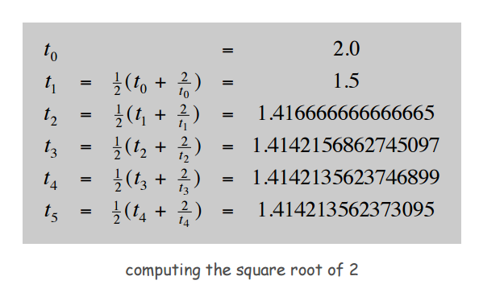
While Loops: Square Root
Goal. Implement Math.sqrt().
% java Sqrt 2.0
1.414213562373095
Newton-Raphson method to compute the square root of c:
Initialize t₀ = c.
Repeat until t_{i} = c / t_{i}, up to desired precision: set t_{i+1} to be the average of t_{i} and c / t_{i}.
15 decimal digits of accuracy in 5 iterations
16

Slide 54
While Loops: Square Root
Goal. Implement Math.sqrt().
% java Sqrt 2.0
1.414213562373095
Newton-Raphson method to compute the square root of c:
Initialize t₀ = c.
Repeat until t_{i} = c / t_{i}, up to desired precision: set t_{i+1} to be the average of t_{i} and c / t_{i}.
15 decimal digits of accuracy in 5 iterations
public class Sqrt {
public static void main(String[] args) { double epsilon = 1e-15;
double c = Double.parseDouble(args[0]); double t = c;
while (Math.abs(t - c/t) > t*epsilon) { t = (c/t + t) / 2.0;
}
System.out.println(t);
relative error tolerance
}
}
17

Slide 55
For Loops

Slide 56
For Loops
The for loop. Another common repetition structure.
Execute initialization statement.
Evaluate a boolean expression.
If true, execute some statements.
And then the increment statement.
Repeat.
loop continuation condition
init
increment
for (init; boolean expression; increment) {
statement 1;
statement 2;
statement 2
}
body
true
statement 1
boolean expression
false
20

Slide 57
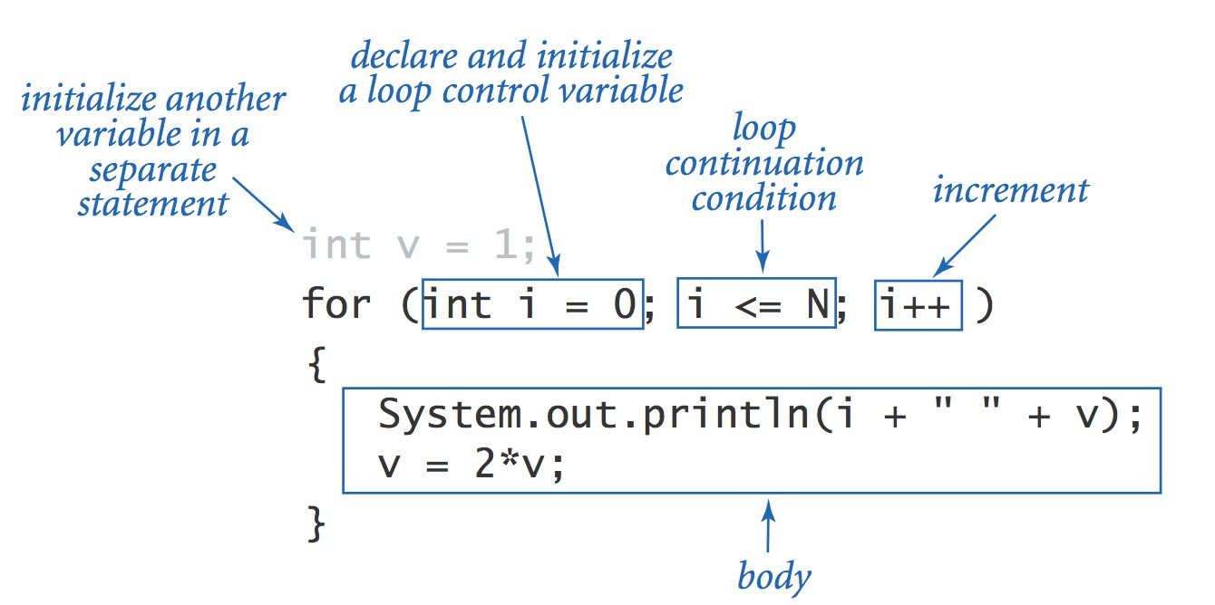
Anatomy of a For Loop
Q. What does it print? A.

Slide 58
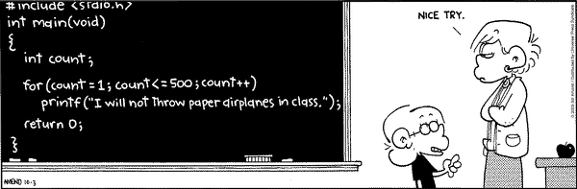
The For Loop
Copyright 2004, FoxTrot by Bill Amend
www.ucomics.com/foxtrot/2003/10/03
19

Slide 59
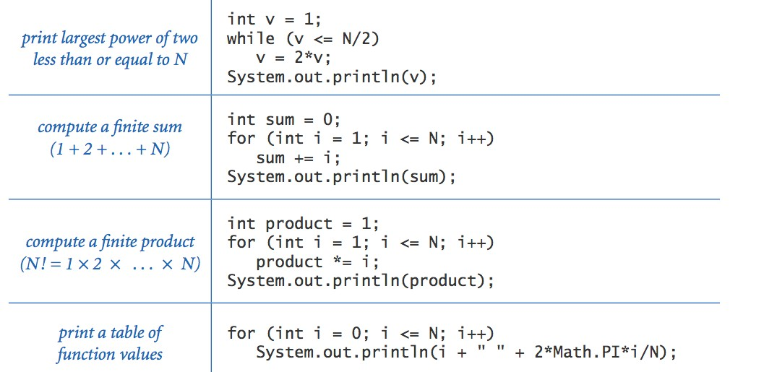
Loop Examples

Slide 60

Monte Carlo Simulation

Slide 61
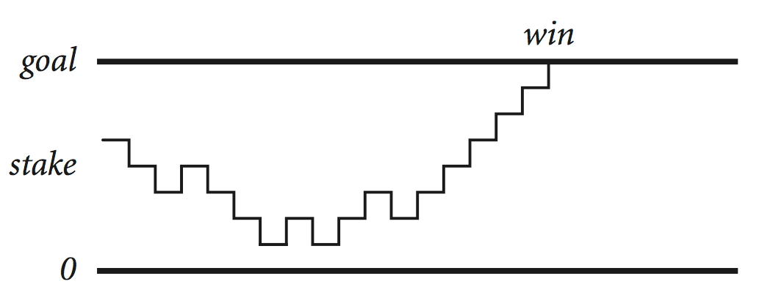
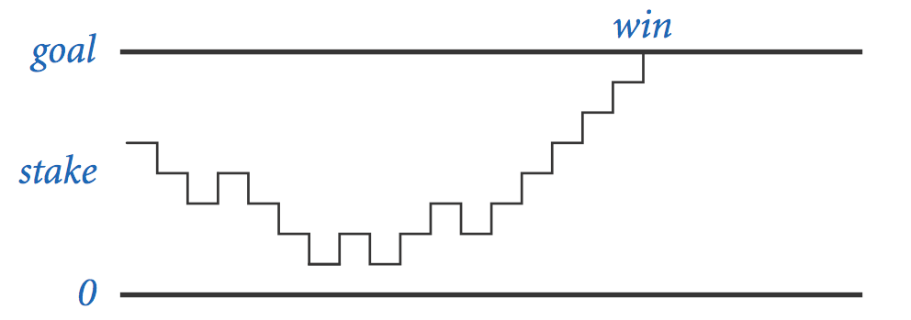
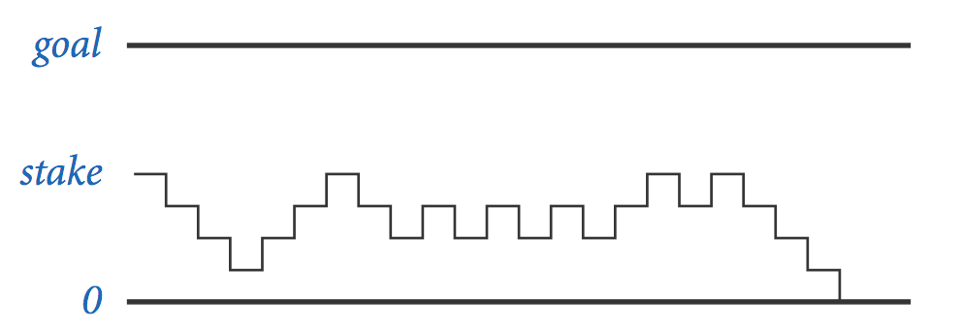
Gambler's Ruin
Gambler's ruin. Gambler starts with $stake and places $1 fair bets until going broke or reaching $goal.
What are the chances of winning?
How many bets will it take?
One approach. Monte Carlo simulation.
Flip digital coins and see what happens.
Repeat and compute statistics.

Slide 62
Gambler's Ruin
public class Gambler {
public static void main(String[] args) {
int stake int goal int T int wins
= Integer.parseInt(args[0]);
= Integer.parseInt(args[1]);
= Integer.parseInt(args[2]);
= 0;
// repeat experiment T times for (int t = 0; t < T; t++) {
}
// do one gambler's ruin experiment int cash = stake;
while (cash > 0 && cash < goal) {
}
if (cash == goal) wins++;
// flip coin and update
if (Math.random() < 0.5) cash++; else cash--;
System.out.println(wins + " wins of " + T);
}
}

Slide 63
Digression: Simulation and Analysis
stake goal T
% java Gambler 5 25 1000
191 wins of 1000
% java Gambler 5 25 1000
203 wins of 1000
% java Gambler 500 2500 1000
197 wins of 1000
after a substantial wait….
Fact. [see ORF 309] Probability of winning = stake ÷ goal.
Fact. [see ORF 309] Expected number of bets = stake ∗ desired gain.
Ex. 20% chance of turning $500 into $2500, but expect to make one million $1 bets.
500/2500 = 20%
500 * (2500 - 500) = 1 million
Remark. Both facts can be proved mathematically; for more complex scenarios, computer simulation is often the best (only) plan of attack.

Slide 64
Control Flow Summary
Control flow.
Sequence of statements that are actually executed in a program.
Conditionals and loops: enable us to choreograph the control flow.
Control Flow
Description
Examples
straight-line programs
all statements are executed in the order given
certain statements are executed depending on the values of certain variables
certain statements are executed repeatedly until certain conditions are met
if if-else
conditionals
loops
while for
do-while

